Slide 1

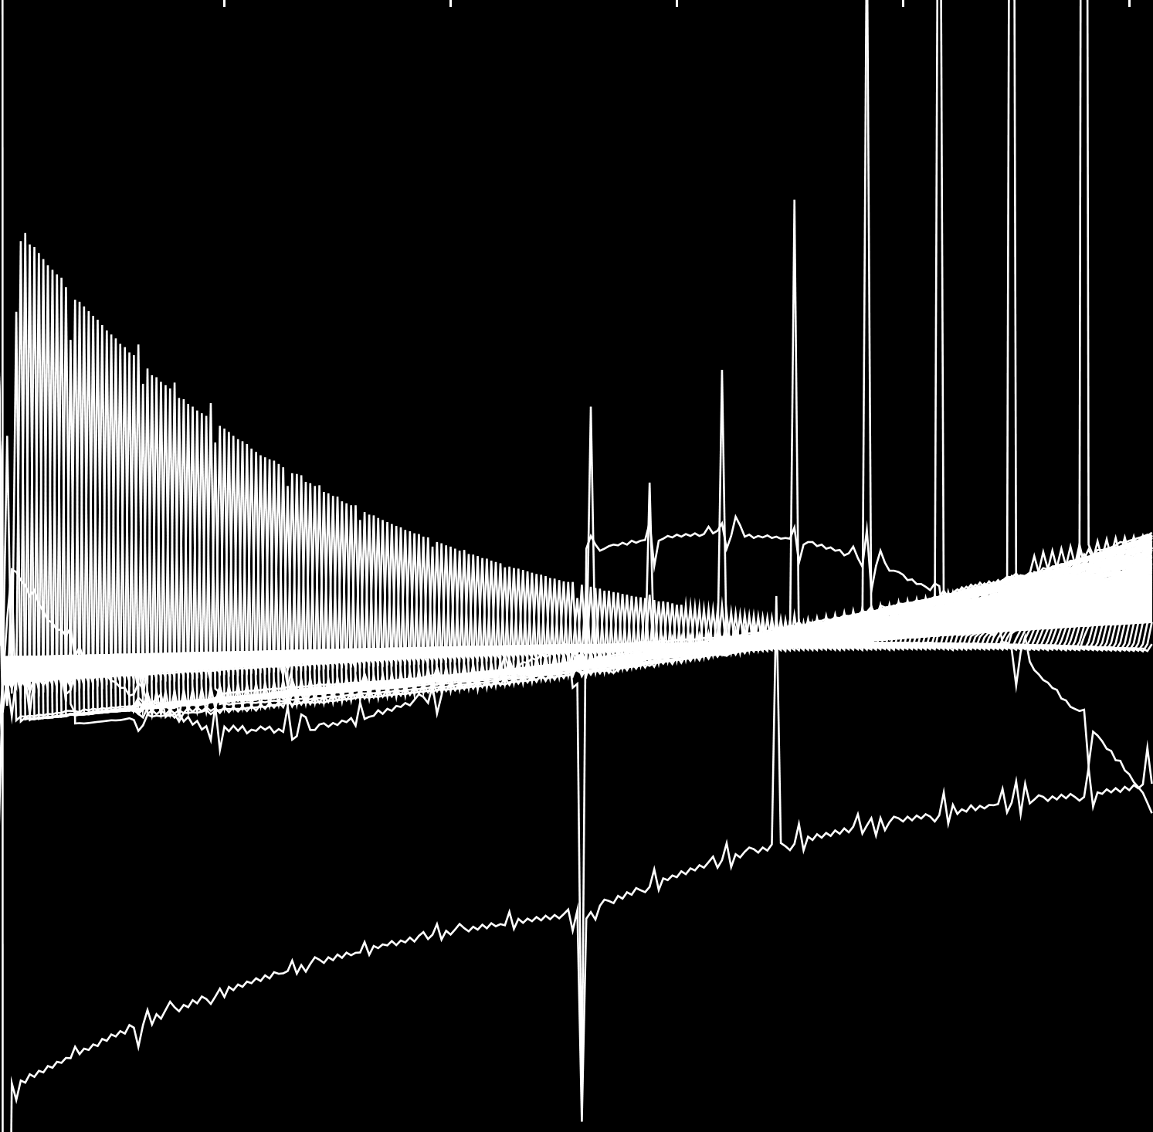
Probabilistic Data Structures in Adversarial Settings
Kenny Paterson
Applied Crypto Group
Department of Computer Science
ETH Zurich
4 March 2021
Visa Research Talk

Slide 2
Agenda
Probablistic Data Structures
Focus 1: Bloom Filters
Focus 2: HyperLogLog (HLL)
Open problems and concluding remarks

Slide 3
Probablistic Data Structures (PDS)
Design and analysis of algorithms and data structures for efficiently handling large data volumes.
Typically sacrifice perfect correctness for efficiency; e.g. approximate set membership, approximate frequency estimtation, finding heavy hitters, approximate cardinality estimation.
Becoming more widely used in practice, especially in the era of big data.
Also a vibrant area of research in CS.
Beautiful analyses using a wide range of mathematical tools.
Results usually focussed on average case performance.

Slide 4
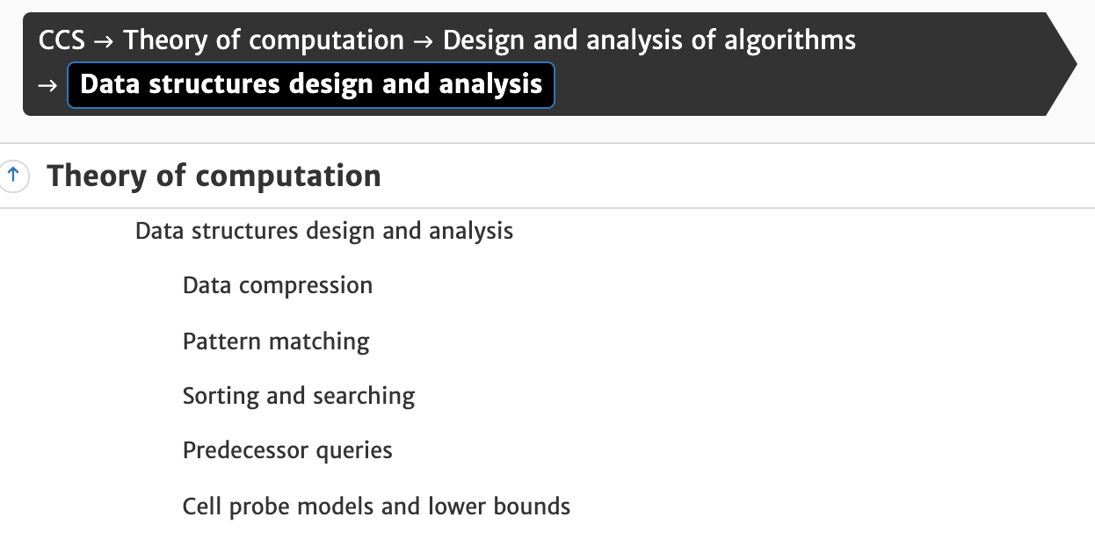
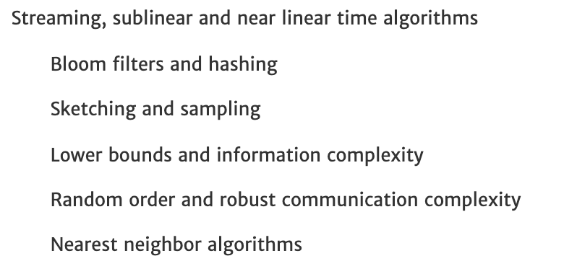
So where are we in TCS?
Adapted from https://www.acm.org/publications/class-2012

Slide 5
Probablistic Data Structures
Many application-specific innovations, e.g. Bloom filter cascades for perfect set membership testing.
Huge range of designs to choose from, more being invented every year.
Theory vs practice divide:
e.g. HyperLogLog (2007) versus KNW (2010) for cardinality estimation.
e.g. MurmurHash versus “k-wise independent hash functions“.
Just like cryptography!
Ubiquity implies potential for abuse: PDS are now being deployed in “adversarial settings“.
Here, the gap between average-case and worst-case performance may be used to adversarial advantage.

Slide 6
Probablistic Data Structures
Thesis of this talk: we can profitably revisit PDS using a cryptographic mindset.
Surveying where PDS are being used beyond their original design envelope.
Developing attacks in these “adversarial“ settings.
Building defences, formally modelling them, understanding the cost of making PDS secure.
Two case studies:
Approximate set membership using Bloom filters;
Approximate counting using HyperLogLog (HLL).

Slide 7
Focus 1: Bloom Filters
A Puzzle:
You have a small amount of memory and a large universe X of possible items.
You want to track which items you have encountered and be able to test whether a potentially new item has been seen before or not.
Exact solutions:
Store an unsorted list of items – fast insertion, slow look-up
Store a sorted list of items – slow insertion, fast look-up.
Use a hash table and linked lists – fast insertion, fast look-up on average.
All these “solutions“ consume memory that is linear in the number of items to be tracked.

Slide 8
Bloom Filters
A Puzzle:
You have a small amount of memory and a large universe X of possible items.
You want to track which elements you have encountered and be able to test whether a potentially new item has been seen before or not.
Approximate solutions:
Bloom filters (1970); Quotient filters (2005); Cuckoo filters (2014).
All trade correctness for compactness.
All have false positives but no false negatives – they support Approximate Membership Queries of a particular type.

Slide 9
Bloom Filters
Suppose we have an m-bit table BF and k independent hash functions:
h_{i}: X →{0,1,2,…,m-1}.
Insertion:
Given x ∊ X, compute h_{i}(x) for each 1 ≤ i ≤ k, and mark the corresponding bits in BF, i.e. set BF(h_{i}(x)) = 1 for each 1 ≤ i ≤ k.
Membership Test:
Given x ∊ X, compute h_{i}(x) for each 1 ≤ i ≤ k, and compute the predicate:
⋀_{i} [ BF(h_{i}(x)) = 1 ].

Slide 10
Bloom Filters
x ∊ X
h₂
h₁
h₃
0
1
m-1

Slide 11
Bloom Filters
x' ∊ X
h₁
h₃
h₂
0
1
m-1
False positives can arise when the predicate is true because of the insertions of other elements y ∊ X.
The more elements are inserted, the higher the chances of a false positive.

Slide 12
Basic Analysis of Bloom Filters
Parameters:
m: number of bits in table BF.
k: number of hash functions.
n: number of items inserted.
False positive probability:
Assuming the hash functions behave randomly, the probability that testing a non-inserted item generates a false positive is (approximately):
ε := (1 – e^{-kn/m})^{k}.

Slide 13
Basic Analysis of Bloom Filters
False positive probability:
Assuming the hash functions behave randomly, the probability that testing a non-inserted item generates a false positive is (approximately):
ε := (1 – e^{-kn/m})^{k}.
Given a target value for n, and a target value for ε, a simple analysis shows that the minimal storage m is reached with:
m/n = -1.44 log₂(ε)
k = - log₂(ε)

Slide 14
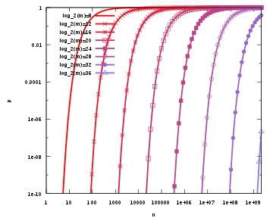
Basic Analysis of Bloom Filters
The false positive probability as a function of number of elements in the filter and the filter size; an optimal number of hash functions has been assumed.
Source: https://en.wikipedia.org/wiki/Bloom_filter#/media/File:Bloom_filter_fp_probability.svg

Slide 15
Bloom Filters in Action
Many variants of Bloom filters have been developed, e.g. for counting number of distinct occurrences of data items.
Bloom filters and variants are widely used in practice.
This includes their use in adversarial scenarios where the input may be chosen to force the Bloom filter to underperform in some way.
We highlight two examples: improving efficiency of database access; CRLite

Slide 16
Bloom Filters in Action – Efficient Database Operation
Is there an item in the db for key value key1?
Database on slow disc
Bloom filter in fast RAM
No!
key1
no
Bloom filter has no false negatives → fast, correct response

Slide 17
Bloom Filters in Action – Efficient Database Operation
Is there an item in the db for key value key2?
Database on slow disc
Bloom filter in fast RAM
Yes!
key2
key2
data item
data item
Database contains item for key2 → disc access necessary

Slide 18
Bloom Filters in Action – Efficient Database Operation
Is there an item in the db for key value key3?
Database on slow disc
Bloom filter in fast RAM
Yes!
key3
key3
no
data item not found
False positive from BF for key3 → disc access redundant

Slide 19
CRLite – using cascaded Bloom filters
J. Larisch, D. Choffnes, D. Levin, B.M. Maggs, A. Mislove, and C. Wilson, CRLite: A scalable system for pushing all TLS revocations to all browsers. IEEE S&P 2017.
Proposes use of cascaded Bloom filters to build compact, perfectly correct data structure for testing certificate revocation status.
Test is for revoked web-PKI certificates X amongst set of all known web-PKI certificates Y.
Works in general when input set X is a static subset of a universe of known inputs Y.
Coupled with regular distribution of freshly computed data structures (since certificate sets X and Y are changing over time), in theory enables private, in-browser revocation checks.

Slide 20
CRLite – using cascaded Bloom filters
Core idea (X revoked certs, Y∖X non-revoked certs):
Build a Bloom filter BF₁ to record all values x ∊ X.
Build a second Bloom filter BF₂ to catch false positives arising in BF₁ (these are elements in Y that are false positives for BF₁).
Build a third Bloom filter BF₃ to catch false positives arising in BF₂ (these are elements in X that are false positives for BF₂).
…
Data structure is collection of all Bloom filters produced.
How many levels are needed?
How to set BF parameters at each level to minimise storage, computation?

Slide 21
CRLite – using cascaded Bloom filters
CRLite proposes a “delta update” mechanism to minimise cost of retransmission of full cascade.
But to minimise total storage, CRLite sets parameters such that false positive rate in each level is close to 1/2.
This means that filters are almost “saturated” – a few more entries and the false positive rate increases rapidly.
This minimises storage but means cascade is always “on the edge” of failure.
This choice limits the usefulness of delta updates: cascade needs to be regularly recomputed from scratch based on current view of X, Y.
Adversarial registration-then-revocation could push popular site (e.g. Google) low down the cascade, making it expensive to check revocation status.
Resilience to Heartbleed-scale revocation event?
Further study needed!

Slide 22

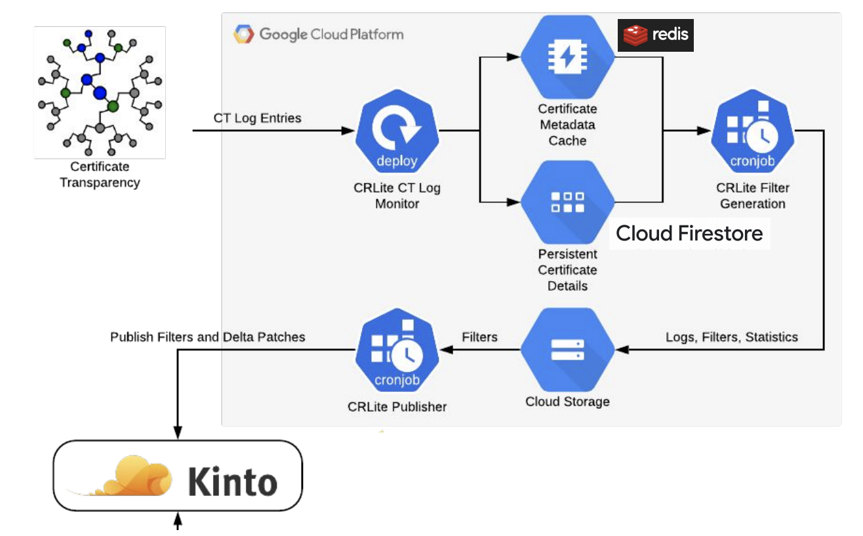
CRLite and Firefox
Mozilla have experimentally deployed CRLite in Firefox (in nightly and beta versions).
Significant engineering effort was required to turn a simple idea into a working system.
One issue is the automated and robust computation of parameters of BFs in the cascade.
A second is data gathering/wrangling to maintain a current view of certificate sets X and Y.
A third is solving the filter cascade distribution problem at scale.
For more details, see the talk by Thyla van der Merwe at RWC 2020: https://rwc.iacr.org/2020/slides/Thyla.pdf
CRLite backend at Mozilla, courtesy Thyla van der Merwe/Mozilla

Slide 23
Bloom Filters in Adversarial Settings
Use of Bloom filter guarantees good average case behaviour.
Can an adversary coerce the system into exhibiting poor performance?
For example, can we tie up the db server (via resource exhaustion/DoS) or force it into marking target inputs as false positives?
”Pollution”, “coverage”, “algorithmic DoS” attacks.
What is possible depends on how we model adversarial capabilities against the system:
Does the adversary already know what has been inserted into the BF?
Can the adversary insert new items?
Are the adversary’s queries interspersed with honest queries?
Does the adversary know the BF parameters and hash functions in use?
Can the adversary read the BF contents?

Slide 24
Formal Modelling for Bloom Filters
This is the kind of work we do when building cryptographic security models!
Define a syntax for the class of objects under study.
Define adversarial capabilities via oracle access to a system.
Define adversarial objective(s) and advantages.
Development of this formal approach (and more) in:
M. Naor and E. Yogev, Bloom filters in adversarial environments, CRYPTO 2015; and
D. Clayton, C. Patton, and T.E. Shrimpton, Probabilistic data structures in adversarial environments, CCS 2019.

Slide 25
Focus 2: HyperLogLog (HLL)
A Puzzle:
You have a small amount of memory and want to count the number of distinct items in a large collection of items X.
This is the problem of cardinality estimation.
How to do it?
How to do it when X is presented in a streaming fashion?
What if approximate counting is good enough?

Slide 26
HyperLogLog (HLL) – Flajolet et al. (2007)
A Solution:
Suppose we have a hash function h: X → {0,1}^{n}.
Assume h has some suitable uniformity property.
Look at the bits of h(x) for each item x and keep track of maximum position of the leftmost 1 bit; call that position M.
h(“dog“) = 10000110: M = 1
h(“cat“) = 01101100: M = 2
h(“fox“) = 11001011: M = 2 (no increase)
h(“pig“) = 00010010: M = 4
Set:
cardinality estimate = 2^{M}.

Slide 27
HyperLogLog (HLL)
Intuition: for a random selection of about 2^{M} distinct values x, expect to see the length M string 0^{M-1}1 as a prefix of h(x) once.
Storage required: log₂(M) bits, hence only log₂log₂(2^{M}) bits.
This provides a statistically unbiased but not very accurate estimator.
Core idea of HLL: Combine many siimple but independent estimators to improve accuracy.
Use leftmost bits n bits of h(x) to determine which one of 2^{n} estimators to update; and rightmost l bits of h(x) to determine how to update that estimator, as before.
Take an average across the different estimators.

Slide 28
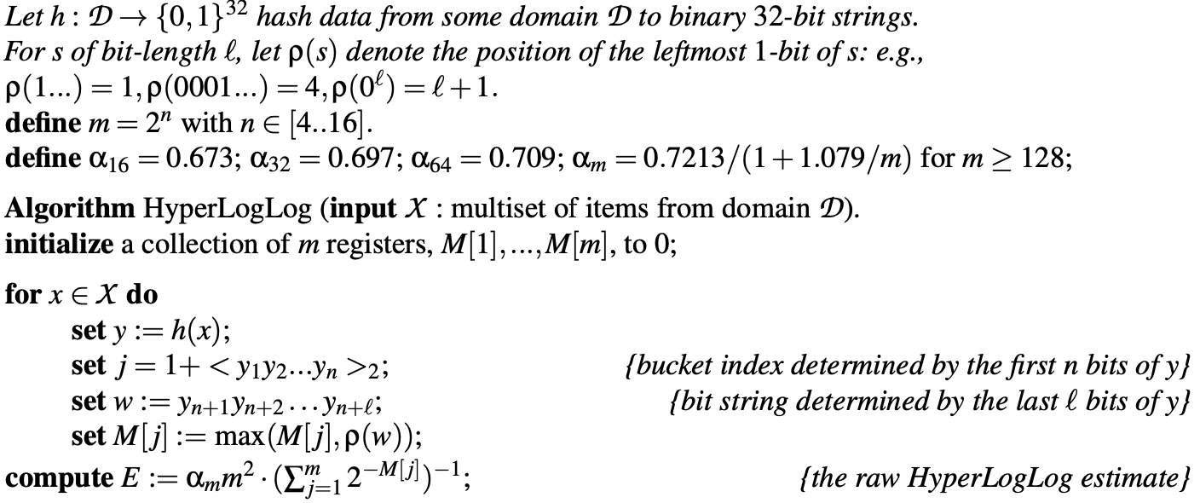
HLL According to Flajolet et al. (2007)

Slide 29
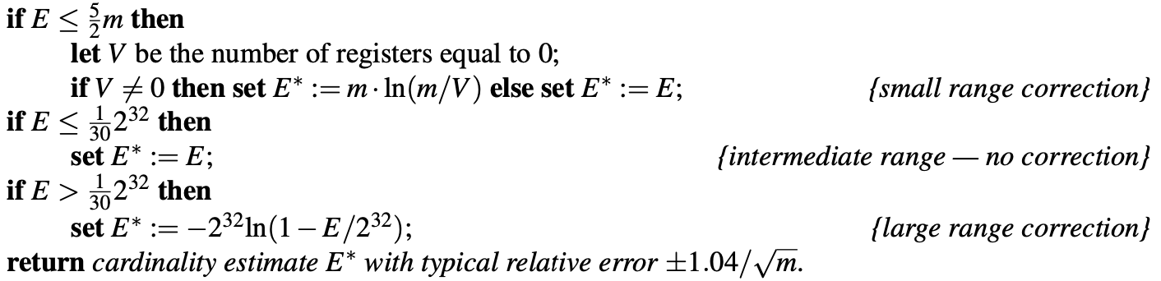
HLL According to Flajolet et al. (2007)

Slide 30
HyperLogLog (HLL)
HLL is increasingly used in real-world applications, including those where the inputs may be adversarially chosen.
Example 1: detecting anomalous network behaviour, such as port scans.
Example 2: counting distinct network flows and using the results to perform congestion control.
Example 3: counting Facebook users.
HLL is widely implemented, e.g. Redis, Google BigQuery, Apache Spark and Druid.

Slide 31
Breaking HLL (joint work with Mathilde Raynal)

Slide 32
Breaking HLL
Core idea:
Assume adversary knows hash function h: X → {0,1}^{n+l} and can select which values x are inserted into the HLL sketch.
Look at the bits of h(x) for each item x and insert only those which begin with "few" zero bits.
This keeps all bucket values M[j] small, and hence also keeps the raw HLL estimate small, even though many items x are inserted.
What if the adversary does not even know the hash function?
Can we find better attacks?
Does it help the attacker to have access to the HLL cardinality estimates? Or even to know the contents of all the buckets?

Slide 33
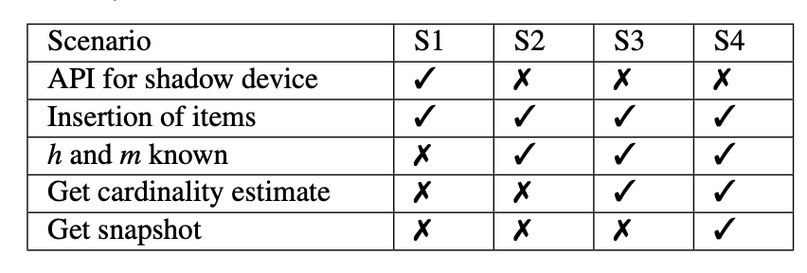
Breaking HLL – Adversary Models
S1, S2: P. Reviriego and D. Ting, “Security of hyperloglog (HLL) cardinality estimation:
Vulnerabilities and protection,” IEEE Commun. Lett., vol. 24, no. 5, pp. 976–980, 2020.
S3, S4: D. Desfontaines, A. Lochbihler, and D. Basin, “Cardinality Estimators do not
Preserve Privacy,” in Proceedings on Privacy Enhancing Technologies, pp. 26–46, 2019.

Slide 34
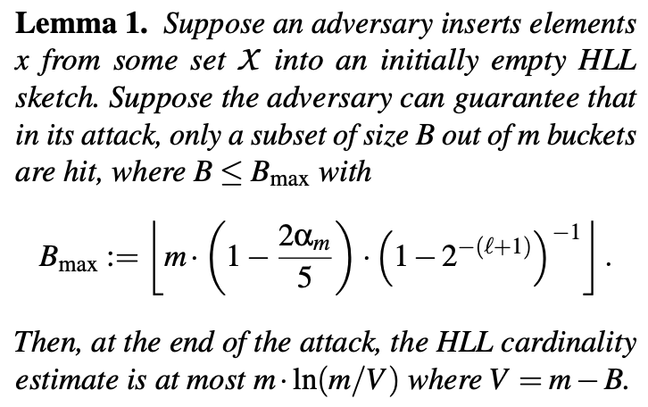
Breaking HLL Better
Approximately 1
Approximately 0.71
Cardinality based on small range correction

Slide 35
Breaking HLL Better
So an attacker can hit about 71% of the buckets with any values M[j] and still stay in the “small range correction” zone!

Slide 36
Breaking HLL Better
Example:
Set B = m/2. Then, in S2, the attacker can expect to insert 1/2 of all inputs and keep cardinality estimate to 0.693m.
Set B = 1. Then, in S2, the attacker can expect to insert a fraction 1/m of all inputs and keep cardinality estimate to 1.
In scenario S2 (insert capability; h and m known) an adversary can insert a constant fraction of all possible inputs and keep the cardinality estimate to a constant, even to 1!
(We implemented the attacks and they work.)

Slide 37
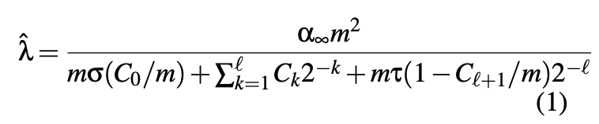
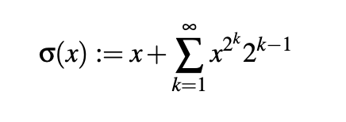
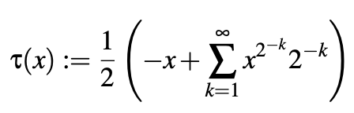
HLL in Practice
In practice, HLL may be implemented differently from ‘‘textbook HLL‘‘.
For example, in Redis:
where:
We analyzed and broke this too.

Slide 38
Repairing HLL
In S1, the adversary is assumed to have access to a shadow device, an exact replica of the target HLL.
Our attacks in S1 are agnostic to the internals of the HLL implementation – they work as long as the shadow device and target device are identical and we have insert, read, and reset access to the shadow device (and insert access to the target)
No dice, cryptographically speaking.
And we have quite strong attacks in this setting.
But this setting does not make much practical sense!

Slide 39
Repairing HLL
In S2, S3, S4, there is hope!
Consider replacing h(⋅ ) with a keyed pseudorandom function (PRF) F(K,⋅ ).
Intuition: the adversary is effectively reduced to the ideal (random input) case, where it cannot influence the cardinality estimate.
We built a formal security model to analyse this.
S4 adversary has access to insert, read, corrupt queries.
Adversary has to distinguish real HLL (y ← F(K,x)) from ideal HLL (y ←$ {0,1}^{n+l}).
Easy to prove a reduction to PRF security of F.

Slide 40
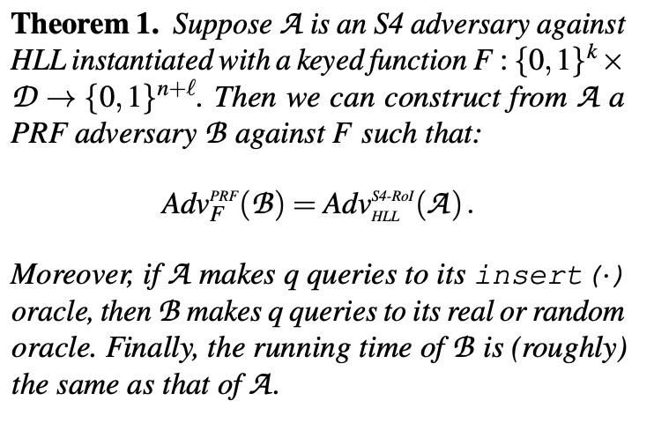
Repairing HLL

Slide 41
Repairing HLL
Instantiating the PRF:
Inputs x typically short.
We want a short-input PRF that is as fast as non-cryptographic hash functions like Murmur3, etc.
Solution: SipHash (Aumasson and Bernstein, 2012).
Has withstood some cryptanalysis attempts.
For 90-byte inputs:
HMAC-SHA-256: 705ns
Murmur3-128: 60ns
SipHash-2-4: 102ns

Slide 42
Some Open Problems
Uncover more scenarios where PDS are used in practice and understand their vulnerabilities.
Expand treatment of [CPS19] to cover a larger range of PDS types.
Perform a deeper security analysis of CRLite and Mozilla‘s implementation of it – find attacks or prove security?
Develop new “zero false positive“ data structures as substitutes for cascaded Bloom filters; analyse their security and efficiency.
HLL is not theoretically optimal but still deployed widely; are the performance gains of HLL alternatives worth the extra complexity? Can they also be secured easily?
Solve the merging problem for secure versions of HLL (or find new data structures that replace HLL and support merging).

Slide 43
Closing Remarks
Probablistic data structures are a fascinating branch of TCS.
They are widely used in practice, in many different kinds of scenarios and with many variants.
Deployments can be vulnerable to attacks of different kinds and different severities.
We have the beginnings of general theory of “secure PDS“, but much remains to be done.
Starting with security in mind, we may even arrive at completely different designs.

Slide 44


Acknowledgements
Thanks to:
Paul Grubbs for interesting discussions that sparked my initial interest in the field, and for providing many research pointers.
Karin Holzhauser (ETH Bachelor‘s thesis on CRLite).
Mathilde Raynal (ETH Semster Project leading to our joint work on HLL).
Tom Shrimpton for discussions and feedback.
Thyla van der Merwe for providing insights into Mozilla‘s on-going deployment of CRLite.

Slide 45
Contact:
Professor Kenny Paterson
Applied Cryptography Group
kenny.paterson@inf.ethz.ch
ETH Zurich
Applied Cryptography Group
Department of Computer Science
Universitätstrasse 6 8092 Zurich, Swizterland
https://appliedcrypto.ethz.ch/

